Slide 1
BRITISH AIRWAYS
Web scraping to find the company insights

Slide 2
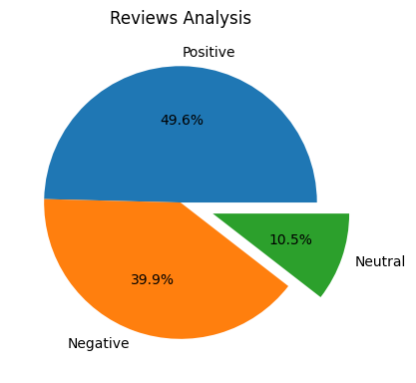
INSIGHTS FROM CUSTOMER RVIEWS
From cleaning 1000 reviews given by the customer, we obtained
Postive reviews – 538
Negative reviews – 347
Neutral reviews - 115

